Slide 1
Timetable Mobile Application
Oskar Ciebien
G00369579
Supervisor:
Mr. Martin Hynes

Slide 2
Context & Objectives
Developing a functional Timetable Mobile Application.
Add, Delete, Edit classes.
Dark mode.
Upload App to the Google Store and Apple App Store.
Security of email, password and Google Two-Factor Authentication.
Easy to use.
Good design.
Merging Data on loss of Internet Connection.
Forgotten Password Functionality.

Slide 3







Technologies & System Architecture
React Native – App
Visual Studio Code – IDE
GitHub – Version Control
Android Studio – Android Emulator
Firebase – Database
Android – Testing Locally and Targeted Device
Apple – Targeted Device (Maybe)

Slide 4

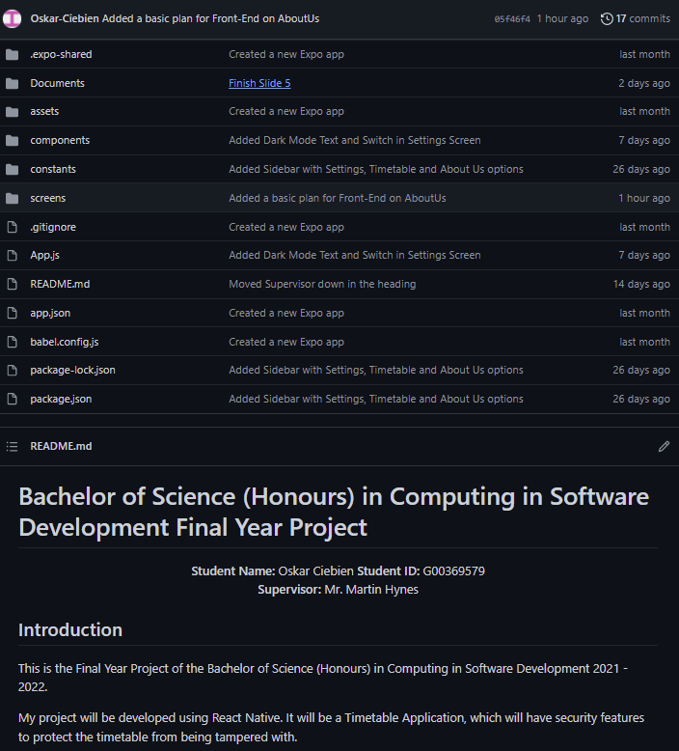
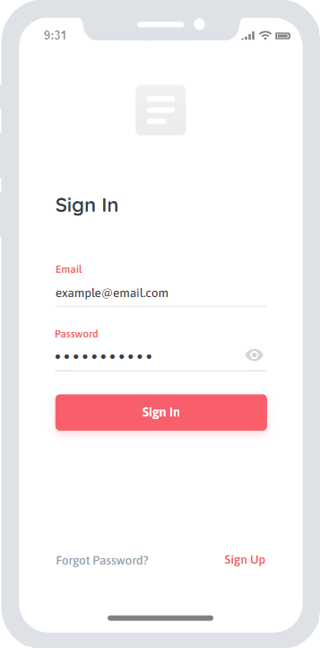
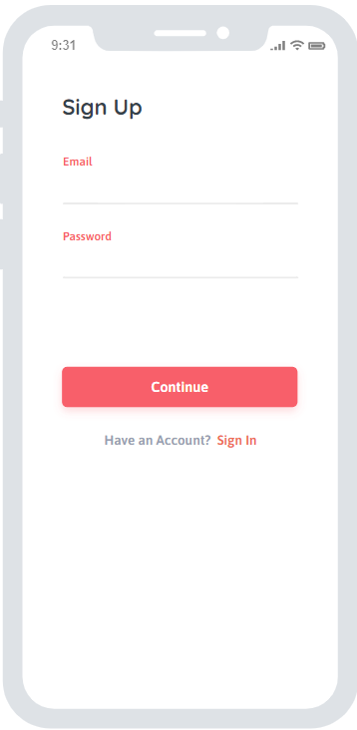
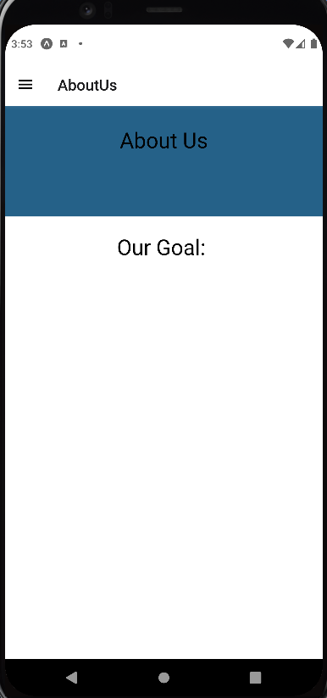
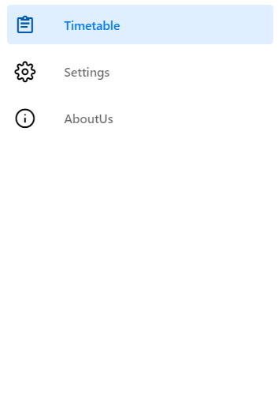
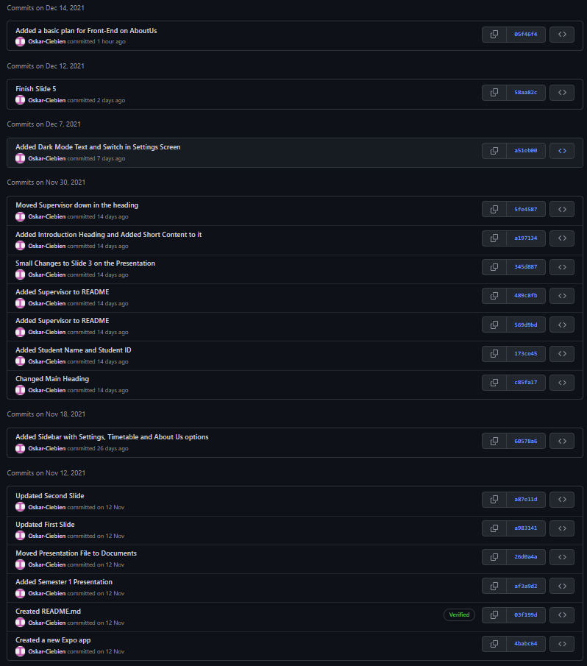
Development & Deployment

